Slide 1


LEANDRO DA COSTA GONÇALVES

Slide 2

INTRODUTION
Framework for distributed computing;
Used in clusters/grids;
Thousands of nodes;
Common hardware;
Petabytes of data;
Open Source (Apache license);
Java;
Originally inspired by Google's MapReduce and GFS.

Slide 3
WHO USES HADOOP?
FACEBOOK;
GOOGLE;
YAHOO;
STOCK EXCHANGE FROM NEW YORK;
CERN.

Slide 4
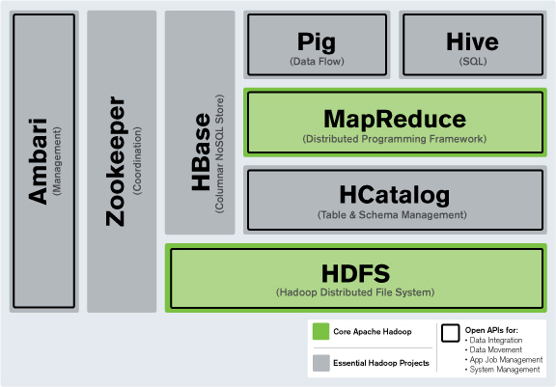
PRINCIPALS COMPONENTS
Fault Tolerance
Distributed processing
Auto-recovery
High bandwidth consuption
Clustering
Highly tolerant of failures

Slide 5
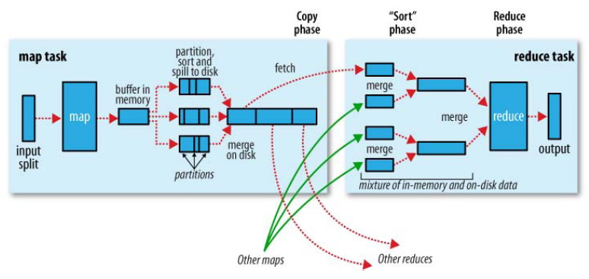
LIFE CYCLE OF MAPREDUCE

Slide 6
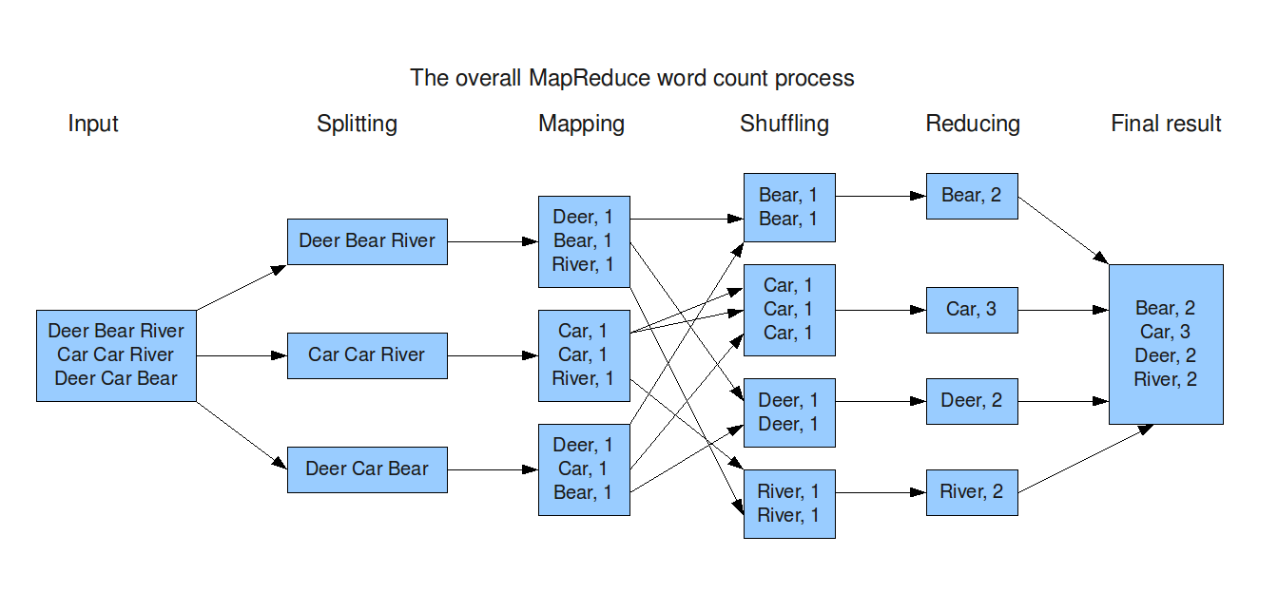
MAPREDUCE OF WORD COUNT

Slide 7
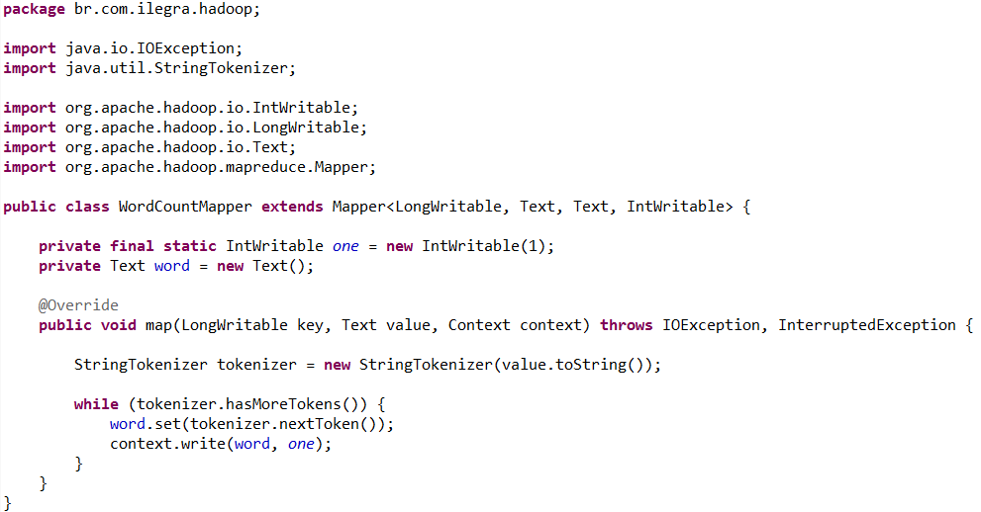
MAPPER

Slide 8
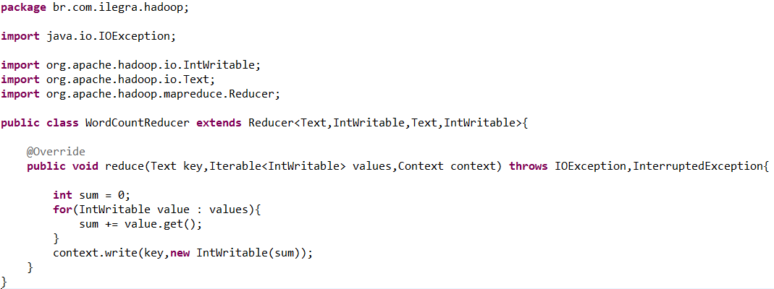
REDUCER

Slide 9
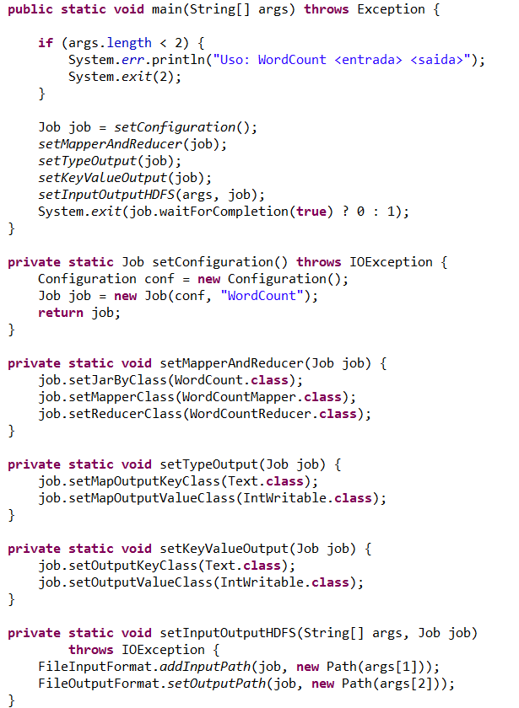
THE MAIN

Slide 10
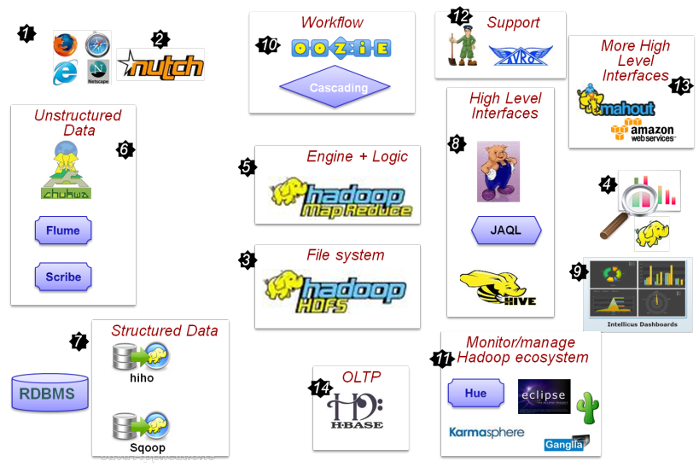
THE HADOOP ECOSYSTEM

Slide 11
CONCLUSION
BigData
The foundations Apache and Spring Source
Google and Facebook
Social networks

